Slide 1
Effective Communication
Week 2
Emotional Intelligence

Slide 2
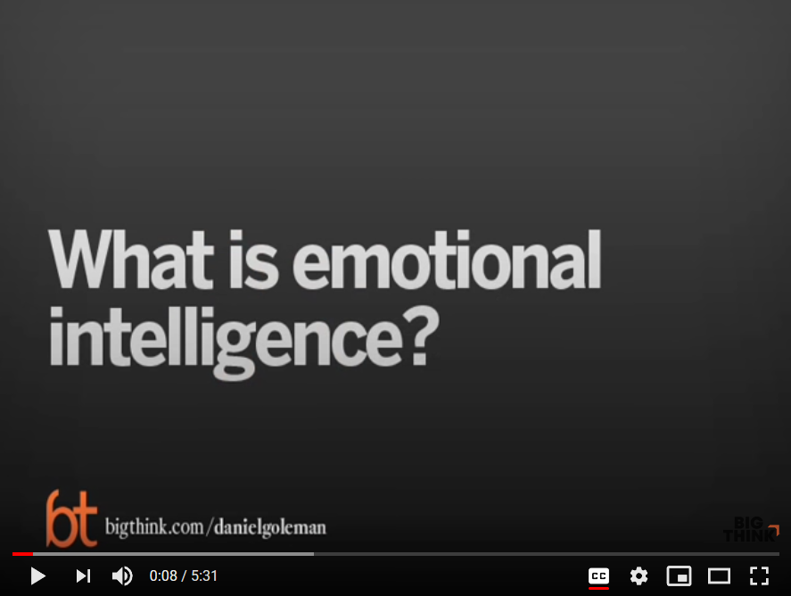
https://www.youtube.com/watch?v=Y7m9eNoB3NU

Slide 3
Emotional Intelligence
IQ
EI is distinct from Intelligence Quotient (IQ). A personal with a high IQ can have a low EI.
Personality
EI is different from ones personality.
EI
EI changes while IQ and personality of a person is more plastic.

Slide 4
Emotional Intelligence
Awareness of ones emotions which helps in self-improvement, as well as
ones social awareness which helps in relationship improvement with others.
What I see
What I do
Self-awareness
Self Management
Social Awareness
Relationship Management
Personal Competence
Social Competence

Slide 5
Self Awareness
Introspection - Self reflection or observation of ones emotions
Reason for feeling the emotions
Leads to
Good intuition
Good decision making
Comfortable in ones skin or self confidence
Good moral compass

Slide 6
Self Management
Separate emotions from distressing situations
Clarity in mind and resolution of conflicts
Channeling positive emotions
Self motivation
Self improvement
Aligning our actions with passions
Successful outcomes

Slide 7
Social Awareness
Empathy – Knowing what someone else is feeling
Helps us connect with others
Inputs from others
Good decision making
Networking
help with resources or collaboration

Slide 8
Relationship Management
Doing what is expected
Conformity to a group and easy to get along with
Mindful of others emotional state
Appropriate action without reaction
Confident inside and outside
Natural leader

Slide 9
Relationship Management
Strong Social Relationships
Longer and healthier life
Lack of strong relationships increased the risk of premature death from all causes by 50% — an effect on mortality risk roughly comparable to smoking up to 15 cigarettes a day, and greater than obesity and physical inactivity.
- Harvard Health Publishing (https://www.health.harvard.edu/healthbeat/strengthen-relationships-for-longer-healthier-life)

Slide 10
Emotional Intelligence
Self Knowledge
Self Control & Motivation
Empathy
Social Skills

Slide 11
Self Awareness Practice
Be sensitive to your senses
Explore your weaknesses
Explore your strengths
Identify your intentions
Pay attention to your actions
Pay attention to your reactions
Are you avoiding situations or sensations

Slide 12
How to expand EI?
Practice
 | Emotional awareness, meditation Emotional Control Self-motivation
 | Acknowledge ones weaknesses
 | Humbleness
 | Personal achievements
 | Level of Happiness
Practice
 | How to react, act, communicate and perform in different emotional states or situations
 | Better outcome instead of emotional exhaust Try to see situations from different angles
 | No burnt bridges
 | Better Relationship

Slide 13
How to expand EI?
Practice
 | Cultivate the attitude of gratitude
 | Be thankful for life and its blessings
 | Be thankful for any new opportunities
 | Appreciate your interactions with others Do not take anything for granted
 | Level of Satisfaction
Practice
 | Be willing to try
 | Accept challenges in life
 | Don’t avoid experiencing new situation/sensation
 | E.g. learn a new language, travel to experience new culture, people, etc.
 | Less Surprises

Slide 14
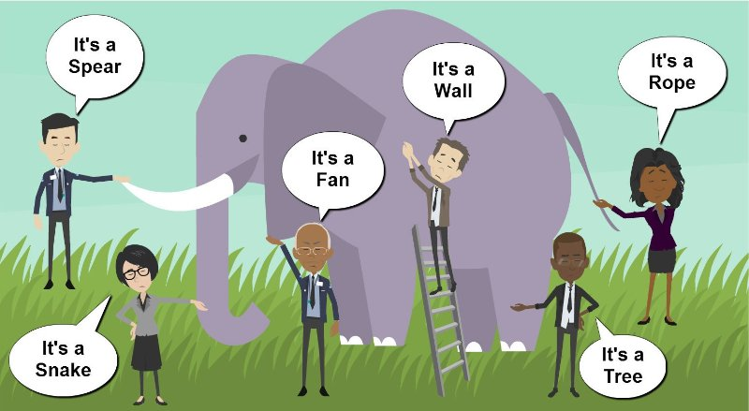
You may be wrong?

Slide 15
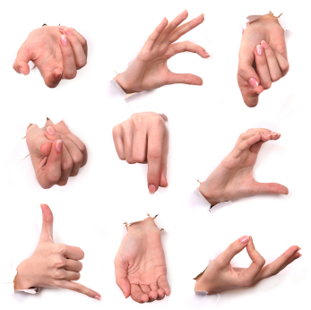
UNDERSTANDING OTHERS
Social Awareness

Slide 16

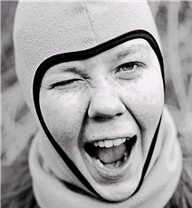
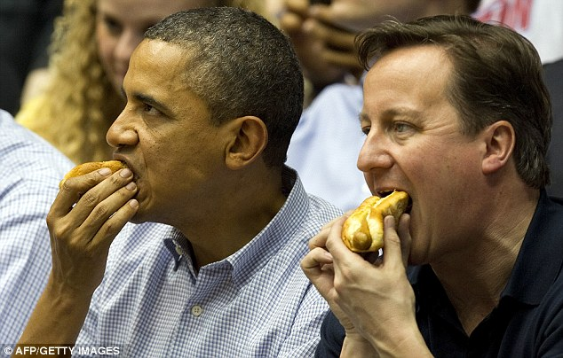

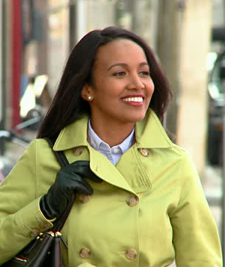
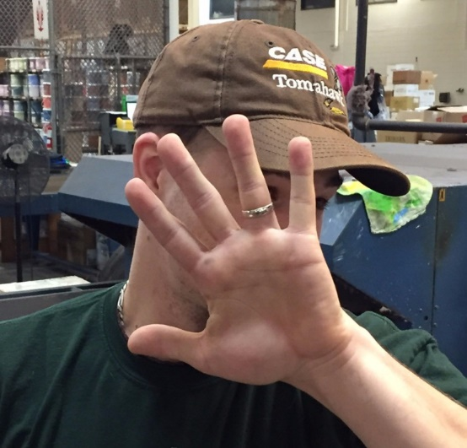

Slide 17
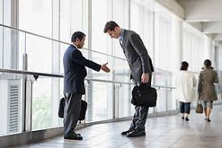
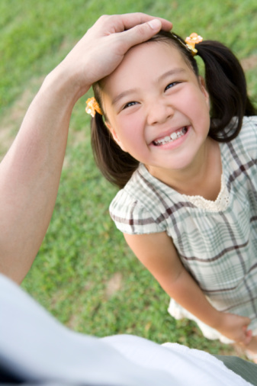

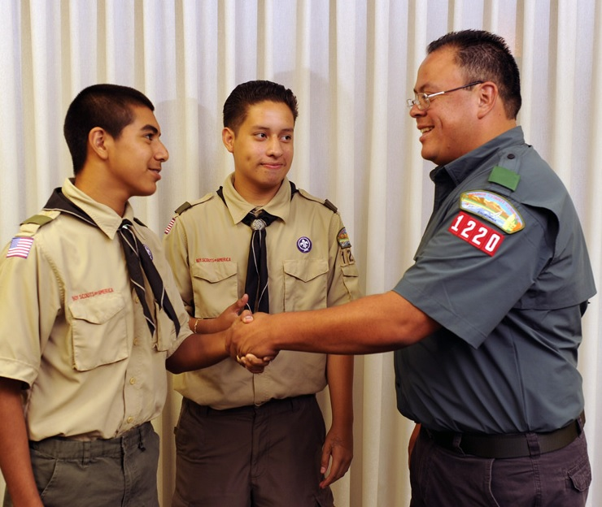
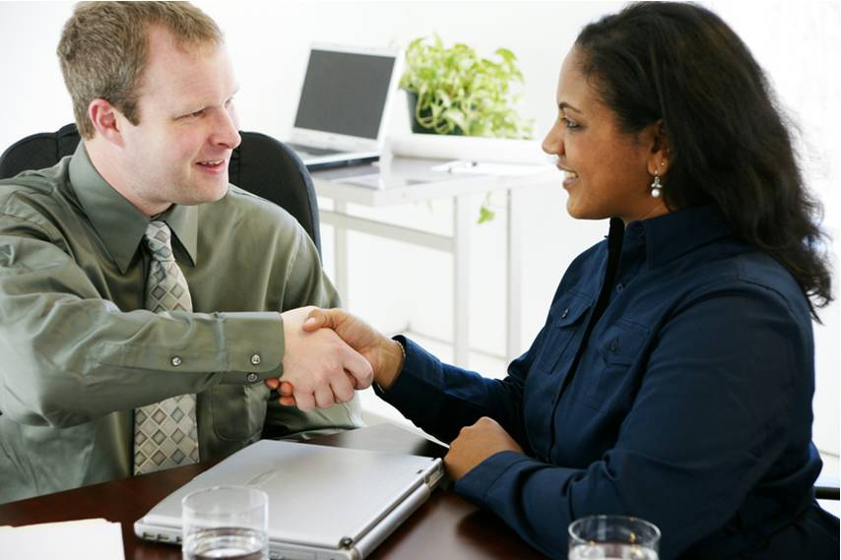

Slide 18
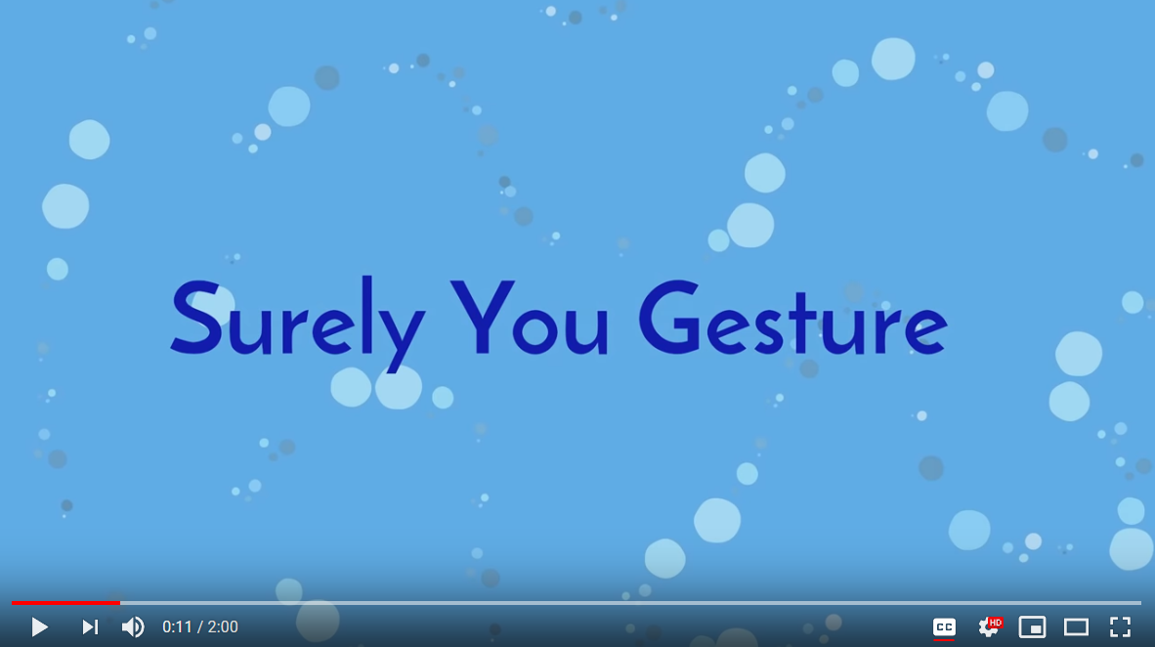
Social Awareness
Gestures
Hand Gestures

Slide 19
Explanations 1
The O.K. sign means something obscene in Brazil, Germany and Russia. It means 'money' in Japan and 'zero' in France.
In many cultures it is very rude to pass or accept items with one hand. In Japan always pass and accept business cards with two hands. Use two hands to present a gift or award in most situations if you are unsure of the local culture. In eastern cultures, giving with left hand is considered rude.
In Bulgaria and Greece nodding the head means 'No'. In some other cultures people will nod to indicate that they are listening to what you have to say, not that they agree with you. It is not a universal gesture.

Slide 20
Explanations 2
In various cultures people smile for different reasons. In Russia smiling is considered foolish, sneaky, or manipulative. The Japanese may smile to mask negative emotions such as anger, confusion or embarrassment. In other cultures people only smile at people they know well and smiling in the street at strangers is considered flirtatious or even lewd behavior.
Sitting in a position that shows the soles of your feet is considered disrespectful in many Eastern European countries, France, the Middle East. You are showing the lowest and dirtiest part of your body.

Slide 21
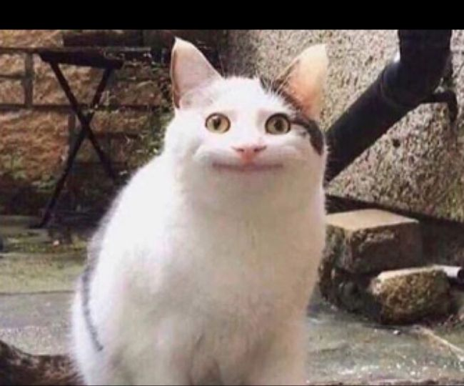
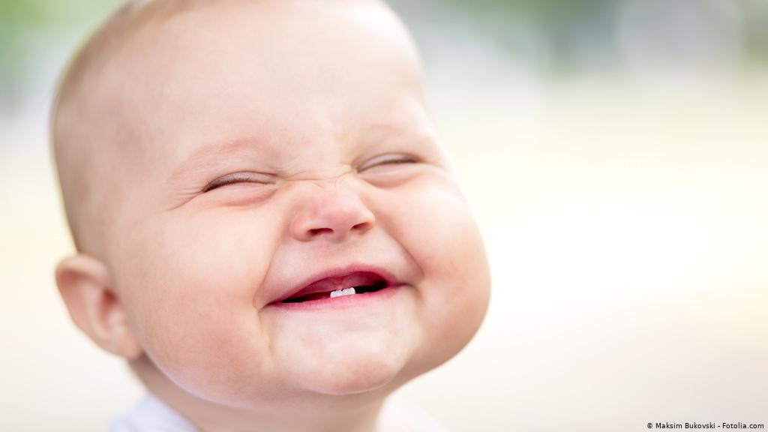


Slide 22
Explanations 3
To use fingers to call a person is insulting in many cultures. Expect a negative reaction (though not always overt) when dealing with learners from the Middle East, Far East, Latin America, Hong Kong and Indonesia.
Pointing in general and especially at people is regarded as unacceptable in many Eastern European, Middle Eastern or Far Eastern cultures. Point with an object such as a pen, if possible.
The 'V' sign can be used to communicate victory or used as a generic gesture in photographs or to indicate the number two. In the UK it communicates something quite different if the palm of the hand is facing inwards. Warn your learners.

Slide 23
Explanations 4
Hand waving while keeping your fingers static can mean 'No' in some languages and cultures. In some South American and African cultures, it can also be an aggressive gesture. See how the locals wave and adapt accordingly.
Holding up an index finger can mean the number two in some European countries, as they start counting with the thumb. In Japan it signifies the number 4, as they count back from the little finger.
In some eastern countries, it is expected to favor business clients with gifts, but western countries like the US are strict and may be deemed unethical.

Slide 24
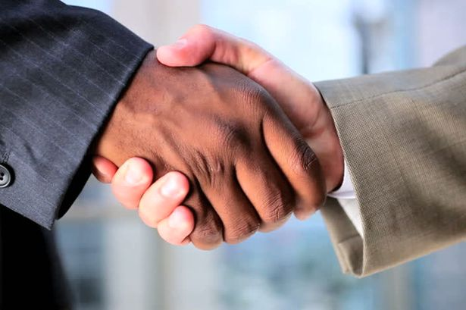
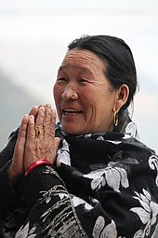
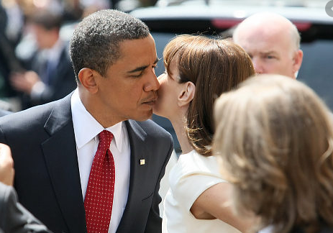
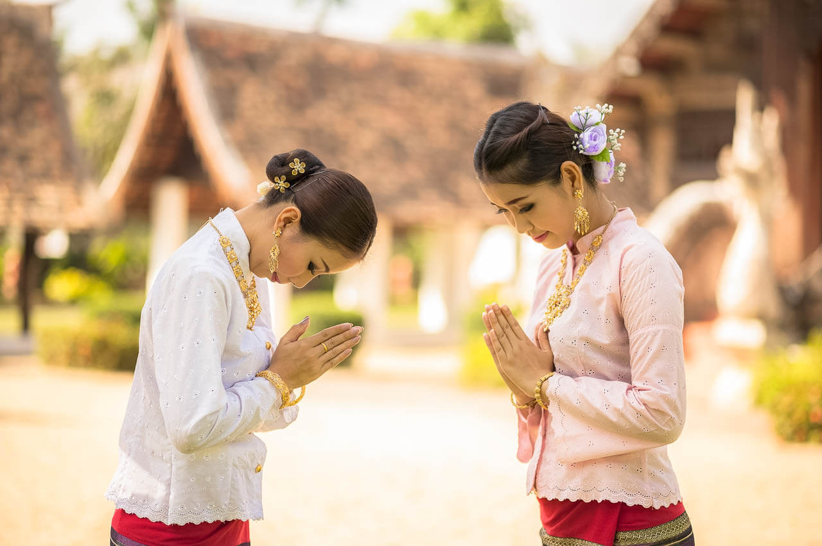
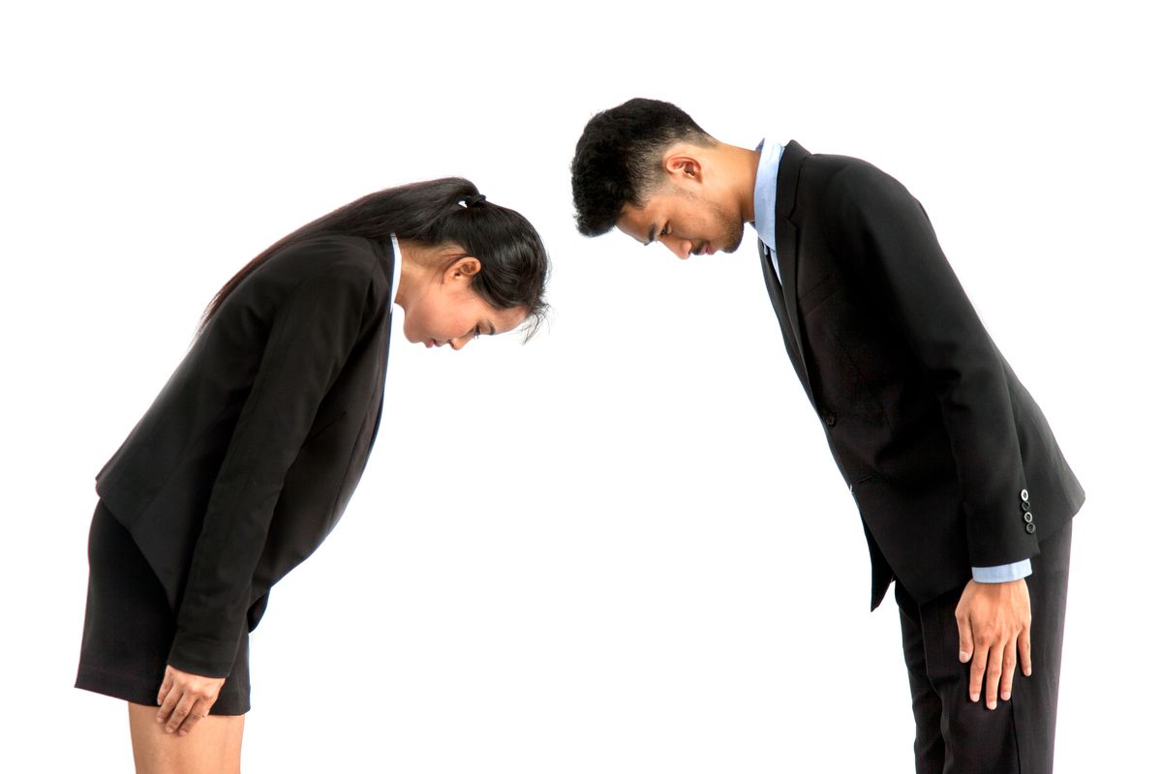
Different Cultures Different Greetings

Slide 25
Greetings in Different Cultures
Eastern Hindu countries
Namaste is preferred; or light handshake is acceptable, especially with younger generations; if you are a man, you don't shake hand with women. However, if a woman initiates handshaking then a male can complete a light handshake.
Brazil
Expect a firm handshake that lasts longer than you’re used to. Mix in strong eye contact, and greet women with a kiss on each cheek. Repeat when you leave.

Slide 26
Greetings in Different Cultures
Many Asian countries
Age matters here, so greet the oldest people first. Grip lightly and bow slightly. Avoid direct eye contact and hold onto the person’s hand a moment or two after the handshake has finished.
Thailand
Don’t shake hands! The person will offer what’s called a “wai,” placing their palms together at chest level and bowing. Return the gesture. If you’re a man, greet then with “Sawadee-krap.” If you’re a woman, say “Sawadee-kah” (both mean “Hello). Shake hands only if a wai is not offered.

Slide 27
Greetings in Different Cultures
Australia
If you’re a woman and you’re shaking a man’s hand, offer your hand first. Typically, women don't shake hands with other women. Shake firm and fast. And no matter what your political ambitions are, never ever use both hands.
USA
Strong handshake is expected; light handshake with women.

Slide 28
Greetings in Different Cultures
France
It doesn’t matter if you’re meeting them for the first or 101st time. Shake their hand quickly and lightly. If you’re close, a kiss on both cheeks is a-okay.
South Korea
The most senior person should start the handshake, and the grip should be soft. Don’t bury your free hand in your pocket, but feel free to clench their right arm with your left hand.

Slide 29
Greetings in Different Cultures
Mexico
Expect a long lasting handshake. If you’re a man, a hug may be in order, too. Women may kiss each other on the cheeks.
Norway
It doesn’t matter who is there, how many people there are, or how old they may be—shake hands with everyone. Call each person by his or her first and last name. Never say, “How are you?” To Norwegians, it’s meaningless conversational fluff.

Slide 30

Things to do!
Consider doing an EI quiz to find out how emotionally intelligent you are: http://www.ihhp.com/free-eq-quiz/
Consider your strengths and weaknesses.
For weaknesses, think about what you can do to help you grow.
Further Reading - Emotional Intelligence: Why It Can Matter More Than IQ by Daniel Goleman
Notes:
SD

Slide 31
Thank you
Effective Communication

